Slide 1
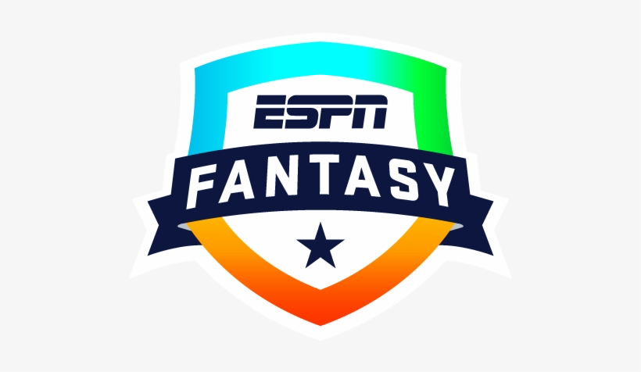
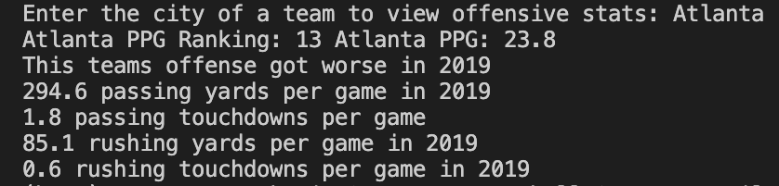
Fantasy
Football
Stats
Helps Fantasy Owners build their team by scraping offensive stats and tells whether the team improved from the previous year.
https://github.com/ksu-is/Fantasy-Football-Stats
Jay Molander & Matt Wilson

